Slide 1
Traffic Sign Detection and Classification System
Submitted in the partial fulfillment for the award of the degree of
BACHELOR OF ENGINEERING
IN
Big Data Analytics
Submitted by:
Yashav Kohli (22BDA70054)
Sheshav Sharma(22BDA70053)
Shinoi Thakur(22BDA70012)
Under the Supervision of:
Dr. Somdatta Patra
Department of AIT-CSE
DISCOVER . LEARN . EMPOWER

Slide 2
Outline
Introduction to Traffic Sign Detection and Classification System
Detection and Classification
System Architecture
Hardware & Software Platform
AI-Powered Classification
Feasibility Analysis
Applications and prospects
Challenges and future direction
References

Slide 3
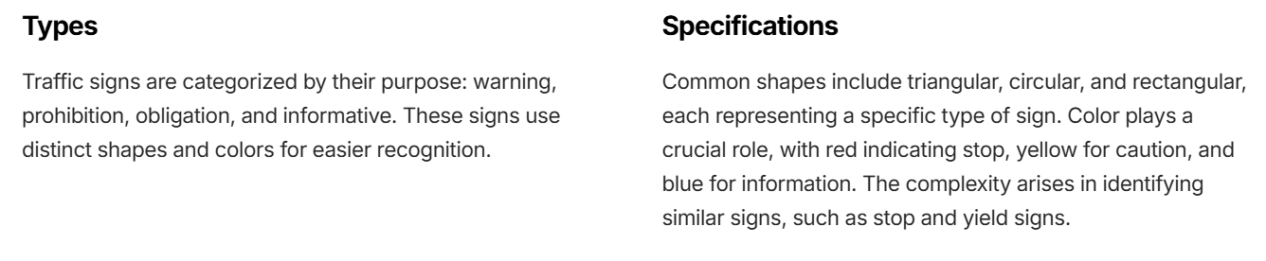
Introduction to Traffic Sign Detection and Classification System
This presentation will discuss the development of a robust traffic sign detection and classification system, exploring its significance in advancing road safety and enabling autonomous driving.
Understanding Traffic Signs

Slide 4
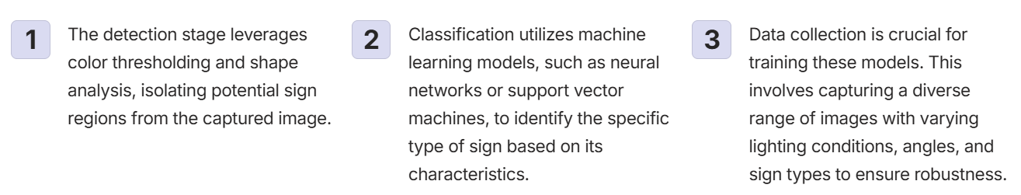
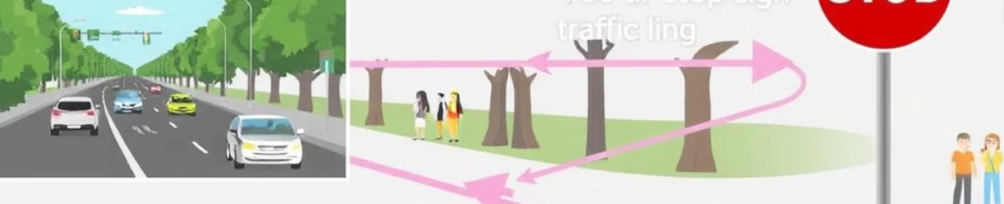
Detection and Classification

Slide 5
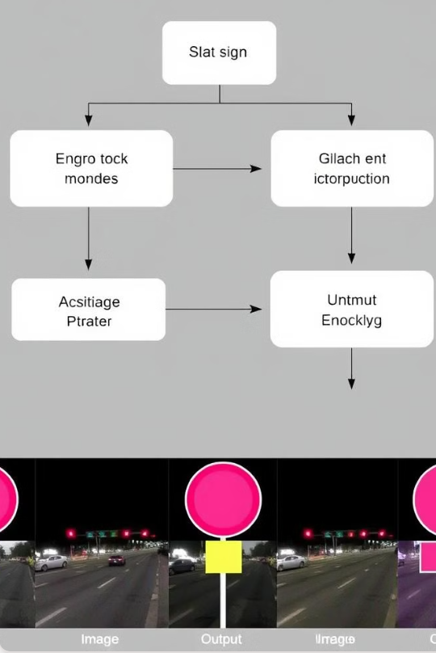
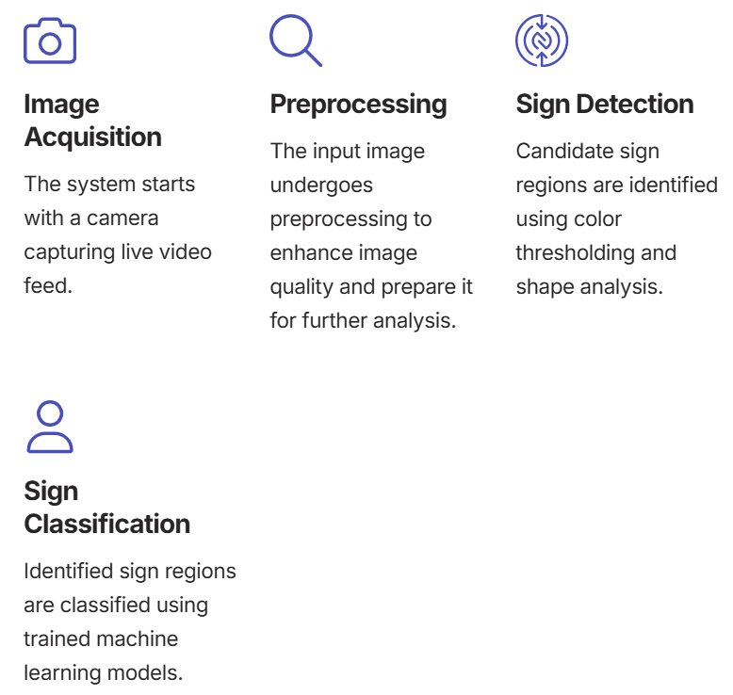
System Architecture

Slide 6
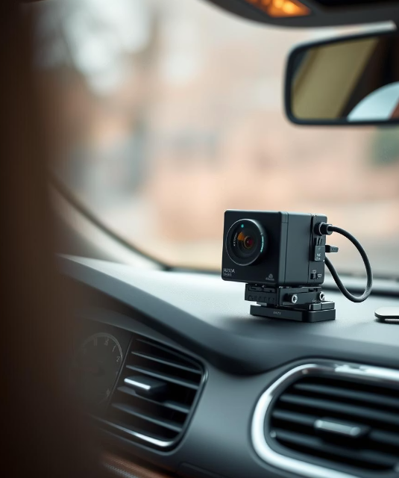
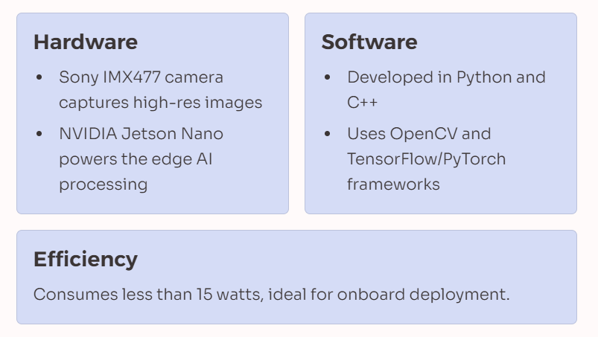
Hardware & Software Platform

Slide 7

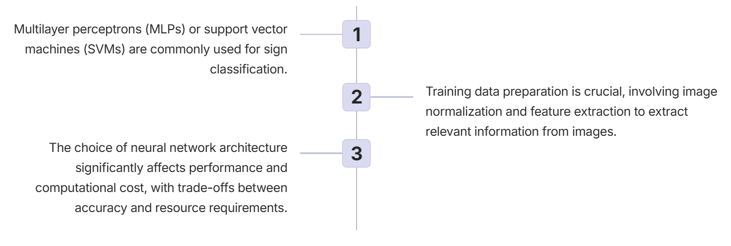
AI-Powered Classification

Slide 8
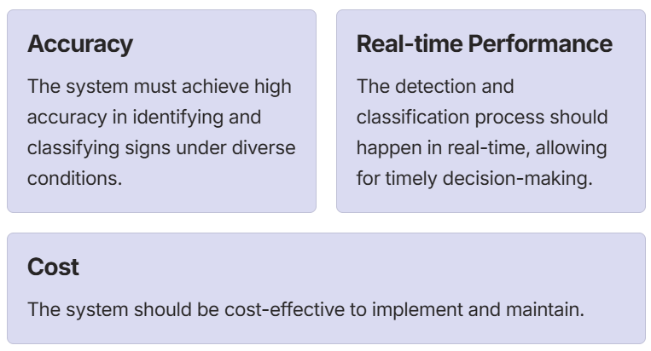
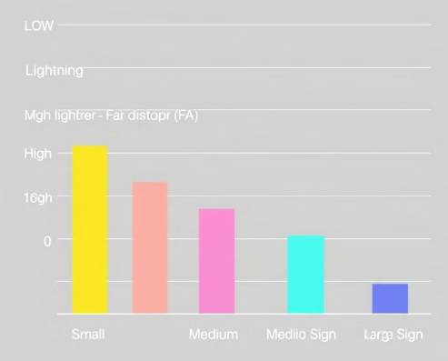
Feasibility Analysis

Slide 9
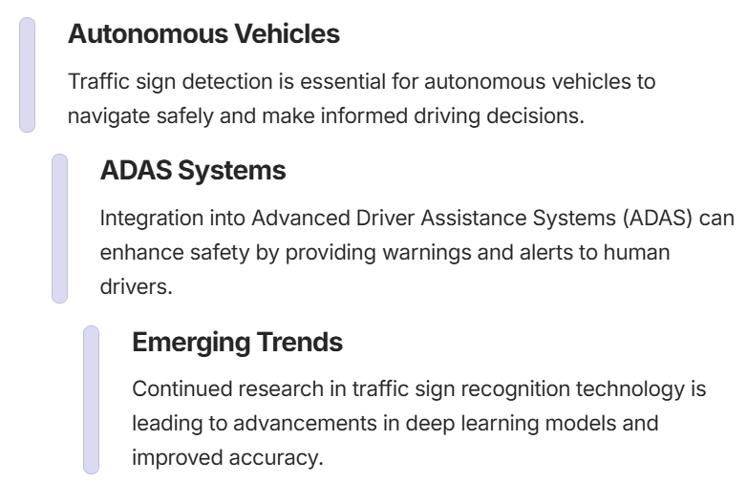
Applications and Prospects

Slide 10
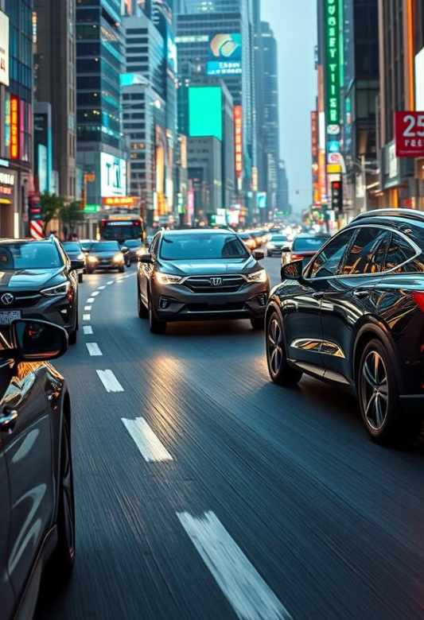
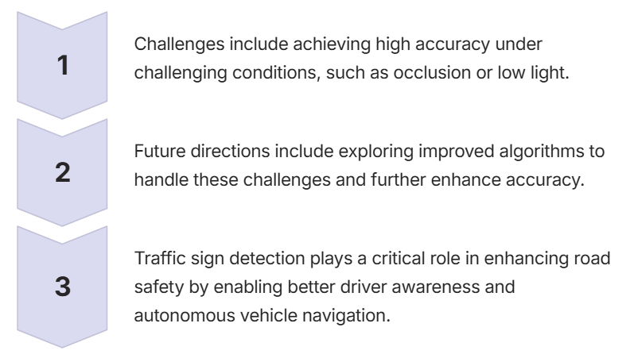
Challenges and Future Directions

Slide 11
References
Research Papers
M. Mathias et al. (2013)"Traffic Sign Recognition - How Far Are We from the Solution?“
Sermanet, P., & LeCun, Y. (2011)"Traffic Sign Recognition with Multi-Scale Convolutional Networks.
Datasets
German Traffic Sign Recognition Benchmark (GTSRB)
A widely used dataset containing over 50,000 images of German traffic signs for recognition tasks.
Belgium Traffic Sign Dataset
Contains images of traffic signs captured in Belgium, focusing on detection challenges.

